Slide 2
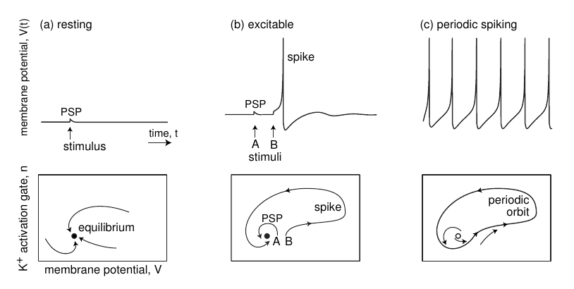

Slide 3
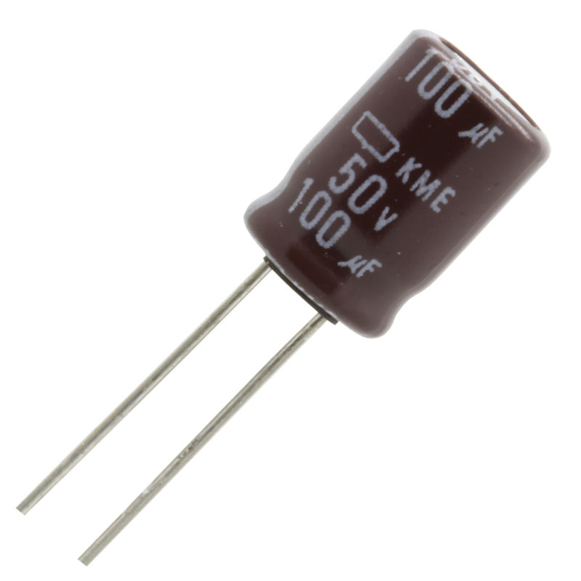
Refractory peroid (P)
Refractory period
Acts actually like a capacitor
Hints:
Because increasing the refractory period will make a delay in the periodic activity of the network. (it will increase say the lambda of the dynamic)
Having more neurons reached to their refractory limit, are potentially a cause of a burst (because they need fires (higher or equal to their threshold to fire)

Slide 4
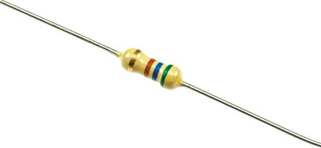
Threshold (th)
Threshold
It acts like a resistor
Hints:
Because increasing the threshold will kill the dynamic more quickly and to start the dynamic more on neurons are needed to initialize the dynamic

Slide 5
The variables:
Membrane potential : number of active neurons
Excitation variable : number of neurons reached to their refractory period ( n[t] – n[t-1] )
Recovery variable :
Adaptation variable :

Slide 6
Observations ( effect of threshold)
Lower thresholds increase the average number of firing neurons
Higher thresholds decrease and damps the average number of firing neurons

Slide 7
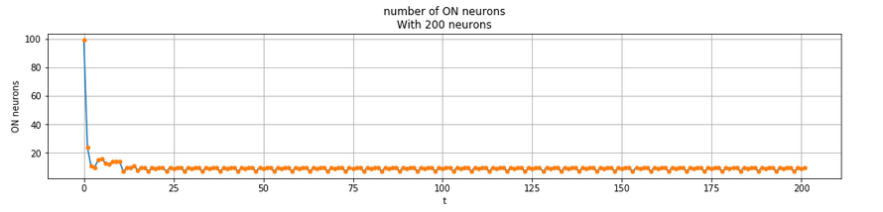
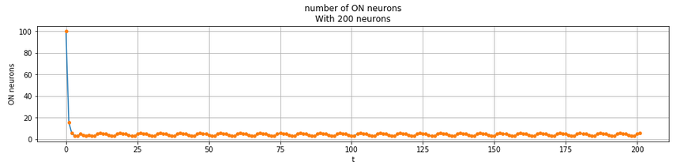
Higher thresholds

Slide 8
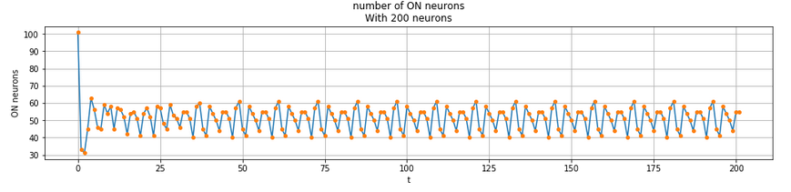
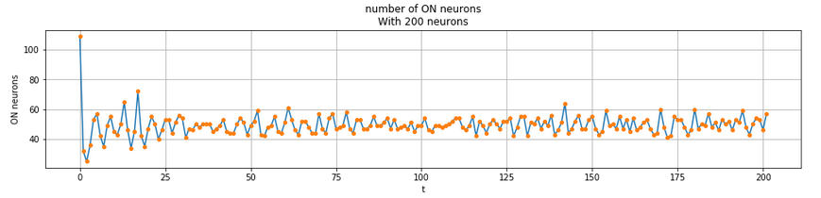
Lower threshold

Slide 9
The effect of Refractory Period
Lower Refractory Period : will decrease the wavelength and increase the number of active neurons
Higher Refractory Period : will increase the wavelength and decrease the number of active neurons (for very large refractory period the dynamic gets killed quickly)

Slide 10
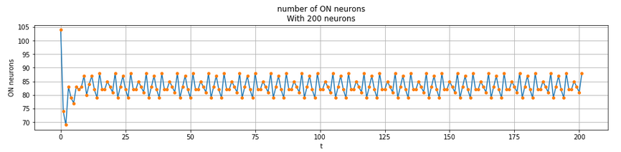
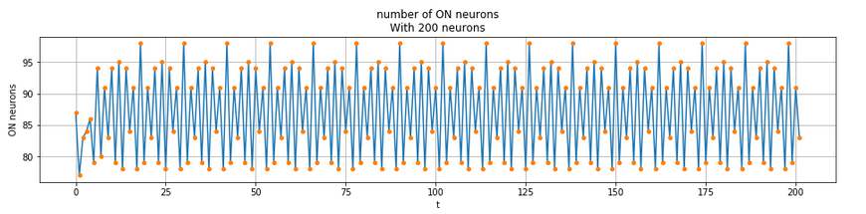
Lower Refractory Period

Slide 11
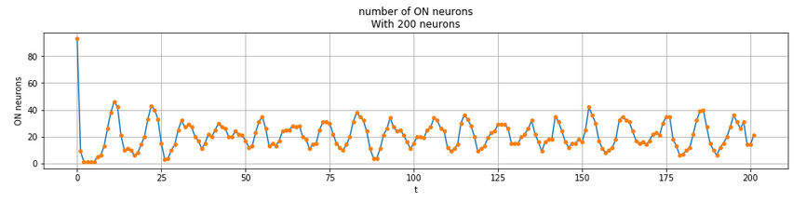

Higher Refractory period
Some of them were killed

Slide 12
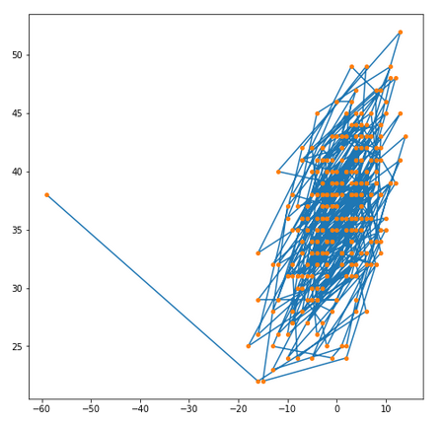
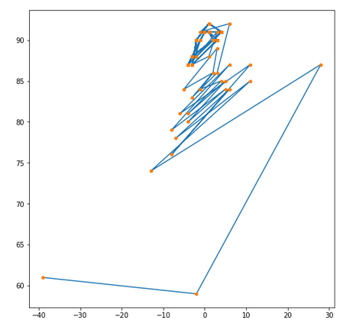
Phase diagram

Slide 13
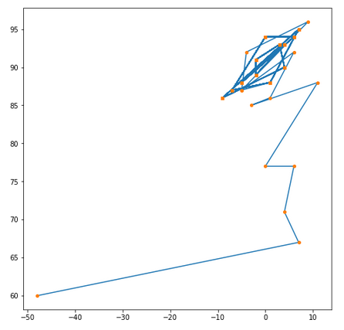
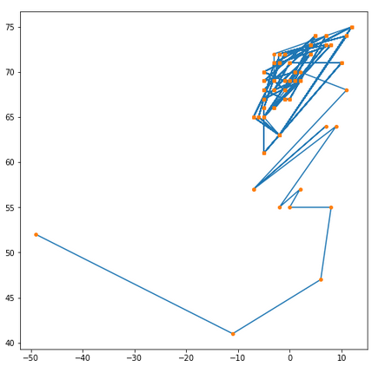
Phase diagram

Slide 14
Observations

